Slide 1
Lab Assignment # 7 Appendix with References
PSY 15
Mandy Small
April 7, 2021

Slide 2
Instructions
Submitting 2 pieces of your project proposal
Appendix cover page with table of content
All of the surveys/questionnaires that you would use to collect data
Reference Page
Assignment #7 is worth 15 points
Your grade will be based on required components plus proper APA format + presentation of questions (all the questions and response options should be formatted similarly and easy to read and respond)

Slide 3
Appendix Cover Page
The first page is a cover page.
Includes a list of all the items (e.g., table of contents).
Also your name, class, the title of your proposal,
The research question, your independent and your dependent variables.

Slide 4
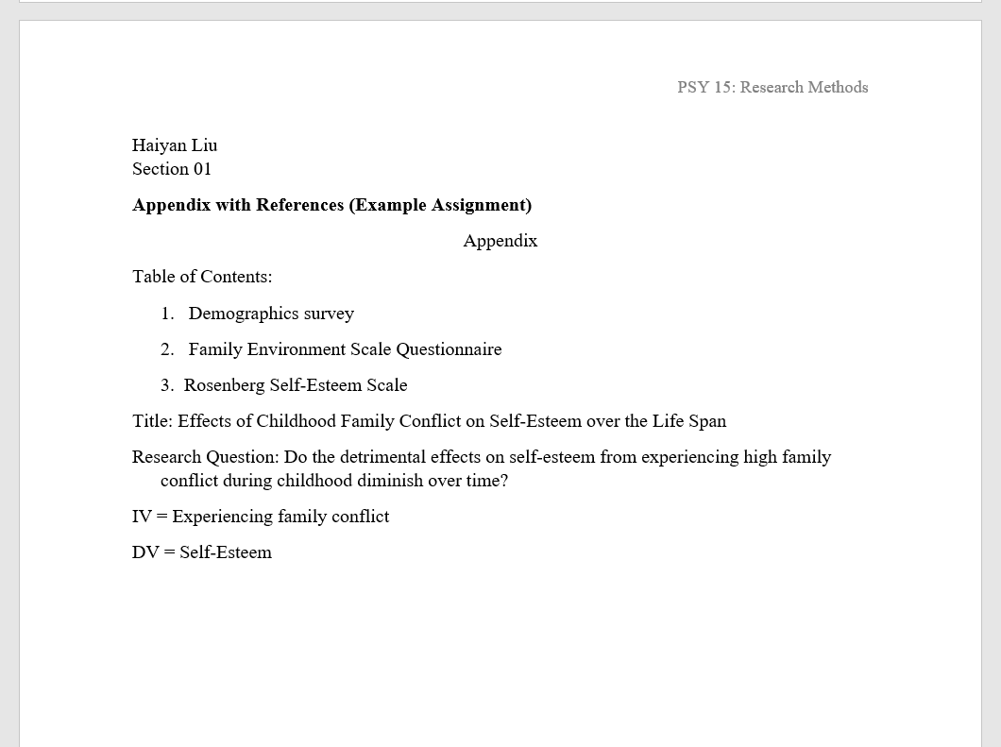

Slide 5
Surveys/Instruments
Include anything you will provide to participants to collect data
Each survey/questionnaire should state on a new page.
If your proposal includes interviews then you appendix will include the interview questions.
If your proposal includes observations then your appendix will include an observation checklist.
If your proposal includes formal survey then your appendix will include the surveys
You should ALWAYS collect basic demographic information when you collect data so include a demographic questionnaire that asks for age, gender/sex, race/ethnicity etc. (include other relevant information, if necessary).
All materials need to be in the clean/formal format that you would provide to participants

Slide 6
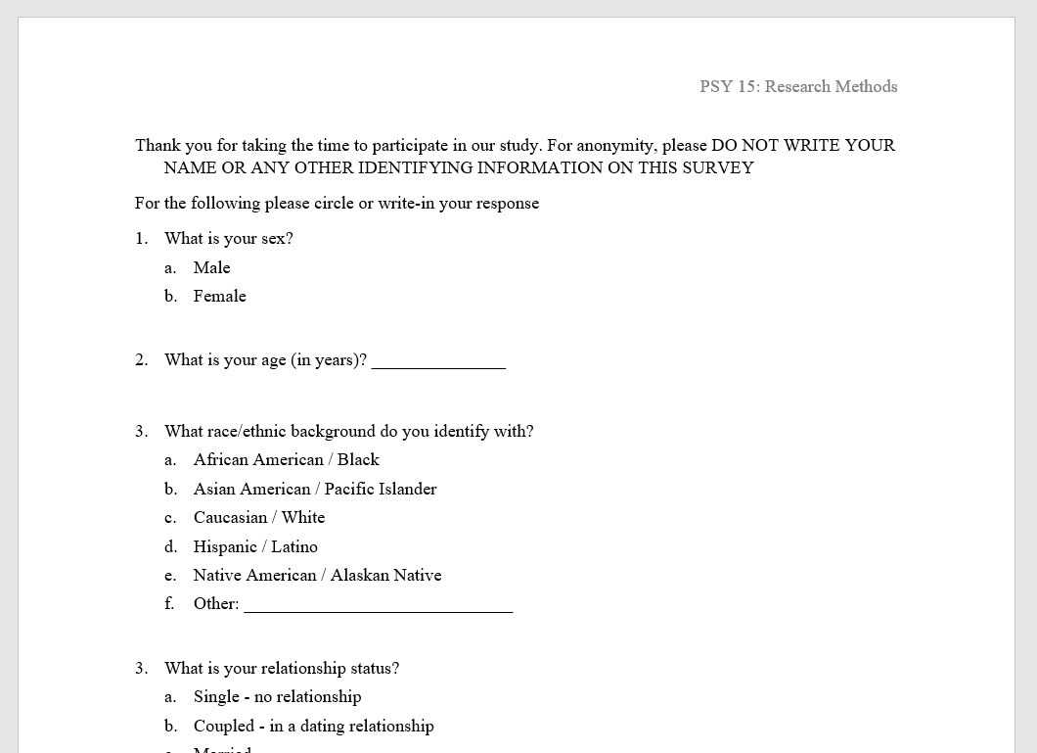

Slide 7
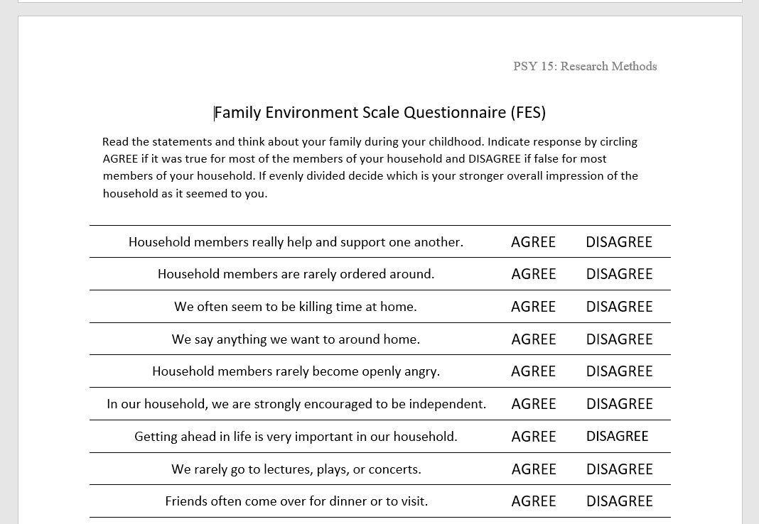

Slide 8
Formatting and Due Date
Type this assignment
12 point, Times New Roman font
Use APA format for reference list
Survey’s should match the creators layout – whenever possible
Submit your work to CatCourses by 11:59 PM on April 14 (no late work will be accepted)
Pdf format only

Slide 9
FAQ
How do I find the surveys
Places to check
1.) Appendix of article you are reading
2.) Method and tables of articles that use the instrument
3.) Web search
***this might take some digging

